Slide 1
Overview
Midterm PREP Script
Question 12
Quesition 20
Question 21
Question 22
Example 7.2 from Nise
Example 7.3 from Nise
Example 7.4 from Nise
Chapter 7 or 8 root Locus Plots

Slide 2
Midterm PREP Script

Slide 3
Chapter 6 --- Stabability Question 1, Nise Textbook
clear all
close all

Slide 4
s^5 +3s^4+5s^3 + 4s^2+s+3
polyVector = [1 3 5 4 1 3]
RouthHurwitz(polyVector)

Slide 5
polyVector =
1 3 5 4 1 3
Routh-Hurwitz Table:
rhTable =
1.0000 5.0000 1.0000
3.0000 4.0000 3.0000
3.6667 0 0
4.0000 3.0000 0
-2.7500 0 0
3.0000 0 0
~~~~~> it is an unstable system! <~~~~~
Number of right hand side poles = 2
Given polynomial coefficients roots :
sysRoots =
-1.6313 + 0.0000i
-0.9407 + 1.5042i
-0.9407 - 1.5042i
0.2563 + 0.7201i
0.2563 - 0.7201i
ans =
1.0000 5.0000 1.0000
3.0000 4.0000 3.0000
3.6667 0 0
4.0000 3.0000 0
-2.7500 0 0
3.0000 0 0

Slide 6
Q2
v2 = [1 0 6 5 8 20]
RouthHurwitz(v2)

Slide 7
v2 =
1 0 6 5 8 20
Routh-Hurwitz Table:
rhTable =
1 6 8
0 5 20
-Inf -Inf 0
NaN NaN 0
NaN NaN 0
NaN NaN 0
~~~~~> it is a stable system! <~~~~~
Number of right hand side poles = 0
Given polynomial coefficients roots :
sysRoots =
0.6641 + 1.8230i
0.6641 - 1.8230i
-0.0000 + 2.0000i
-0.0000 - 2.0000i
-1.3283 + 0.0000i
ans =
1 6 8
0 5 20
-Inf -Inf 0
NaN NaN 0
NaN NaN 0
NaN NaN 0

Slide 8
syms s
(s+1)*(s+2)*(s+3)*(s+4)
ans =
(s + 1)*(s + 2)*(s + 3)*(s + 4)

Slide 9
syms a b c EPS;
syms a b c EPS;
ra=routh([1 a b c],EPS)
ra =
[ 1, b]
[ a, c]
[ -(c - a*b)/a, 0]
[ c, 0]

Slide 10
Question 12

Slide 11
K(s+2)/s(s-1)(s+3)
syms s K EPS;
ra2 = routh([1 2 K-3 2],EPS)
ra2 =
[ 1, K - 3]
[ 2, 2]
[ K - 4, 0]
[ (2*K - 8)/(K - 4), 0]

Slide 12
Quesition 20

Slide 13
ra3 = routh([K+1 3 2+K],EPS)
ra3 =
[ K + 1, K + 2]
[ 3, 0]
[ K + 2, 0]

Slide 14
Question 21

Slide 15
ra4 = routh([1 5 4+K 6*K],EPS)
% solve(4 - K/5==0)
% solve((6*K*(K - 20))/(5*(K/5 - 4))==0)
ra4 =
[ 1, K + 4]
[ 5, 6*K]
[ 4 - K/5, 0]
[ (6*K*(K - 20))/(5*(K/5 - 4)), 0]

Slide 16
Question 22

Slide 17
syms a b c EPS;
ra5 = routh([1 K-b -a],EPS)
ra5 =
[ 1, -a]
[ K - b, 0]
[ -a, 0]

Slide 18
Example 7.2 from Nise

Slide 19
syms s
Gs = 120*(s+2)/((s+3)*(s+4))
CSlashR = simplify(Gs/(1+Gs))
polyVector = [1 127 252]
routh([1 127 252],EPS)
limit(Gs,s,0)
limit(s*Gs,s,0)
limit(s^2*Gs,s,0)

Slide 20
Gs =
(120*s + 240)/((s + 3)*(s + 4))
CSlashR =
(120*s + 240)/(s^2 + 127*s + 252)
polyVector =
1 127 252
ans =
[ 1, 252]
[ 127, 0]
[ 252, 0]
ans =
20
ans =
0
ans =
0

Slide 21
Example 7.3 from Nise

Slide 22
syms s
Gs =100*(s+2)*(s+6)/(s*(s+3)*(s+4))
CSlashR = simplify(Gs/(1+Gs))
polyVector = [1 107 812 1200]
routh(polyVector, EPS)
%R(s) = 5*1/s
limit(5/(1+Gs),s,0)

Slide 23
Gs =
((100*s + 200)*(s + 6))/(s*(s + 3)*(s + 4))
CSlashR =
(100*s^2 + 800*s + 1200)/(s^3 + 107*s^2 + 812*s + 1200)
polyVector =
1 107 812 1200
ans =
[ 1, 812]
[ 107, 1200]
[ 85684/107, 0]
[ 1200, 0]
ans =
0

Slide 25
Example 7.4 from Nise

Slide 26
Gs = 10*(s+20)*(s+30)/((s*(s+25)*(s+35)))
CSlashR = simplify(Gs/(1+Gs))
polyVector = [1 70 1375 600]
routh(polyVector, EPS)

Slide 27
Gs =
((10*s + 200)*(s + 30))/(s*(s + 25)*(s + 35))
CSlashR =
(10*s^2 + 500*s + 6000)/(s^3 + 70*s^2 + 1375*s + 6000)
polyVector =
1 70 1375 600
ans =
[ 1, 1375]
[ 70, 600]
[ 9565/7, 0]
[ 600, 0]

Slide 28
Gs = 10*(s+20)*(s+30)/((s^2*(s+25)*(s+35)*(s+50)))
CSlashR = simplify(Gs/(1+Gs))
polyVector = [1 110 3875 43760 500 6000]
routh(polyVector, EPS)

Slide 29
Gs =
((10*s + 200)*(s + 30))/(s^2*(s + 25)*(s + 35)*(s + 50))
CSlashR =
(10*s^2 + 500*s + 6000)/(s^5 + 110*s^4 + 3875*s^3 + 43760*s^2 + 500*s + 6000)
polyVector =
1 110 3875 43760 500 6000
ans =
[ 1, 3875, 500]
[ 110, 43760, 6000]
[ 38249/11, 4900/11, 0]
[ 1673237240/38249, 6000, 0]
[ -1316030750/41830931, 0, 0]
[ 6000, 0, 0]

Slide 30
G1(s) = 500*(s+2)*(s+5)/((s+8)*(s+10)*(s+12))
G2(s) = 500*(s+5)*(s+5)*(s+6)/(s*(s+8)*(s+10)*(s+12))
G3(s) = 500*(s+2)*(s+4)*(s+5)*(s+6)*(s+7)/(s^2*(s+8)*(s+10)*(s+12))
Func1 = (simplify(G1(s)/(1+G1(s))))
Func2 = (simplify(G2(s)/(1+G2(s))))
Func3 = (simplify(G3(s)/(1+G3(s))))

Slide 31
G1(s) =
((500*s + 1000)*(s + 5))/((s + 8)*(s + 10)*(s + 12))
G2(s) =
((500*s + 2500)*(s + 5)*(s + 6))/(s*(s + 8)*(s + 10)*(s + 12))
G3(s) =
((500*s + 1000)*(s + 4)*(s + 5)*(s + 6)*(s + 7))/(s^2*(s + 8)*(s + 10)*(s + 12))
Func1 =
(500*s^2 + 3500*s + 5000)/(s^3 + 530*s^2 + 3796*s + 5960)
Func2 =
(500*(s + 5)^2*(s + 6))/(s^4 + 530*s^3 + 8296*s^2 + 43460*s + 75000)
Func3 =
(500*s^5 + 12000*s^4 + 111500*s^3 + 498000*s^2 + 1058000*s + 840000)/(501*s^5 + 12030*s^4 + 111796*s^3 + 498960*s^2 + 1058000*s + 840000)

Slide 32
[n1,d1] = numden(Func1)
routh(sym2poly(d1), EPS)
[n2,d2] = numden(Func2)
routh(sym2poly(d2), EPS)
[n3,d3] = numden(Func3)
routh(sym2poly(d3), EPS)
Kp = limit(G1(s),s,0)
Kv = limit(s*G2(s),s,0)
Ka = limit(s^2*G3(s),s,0)

Slide 33
n1 =
500*s^2 + 3500*s + 5000
d1 =
s^3 + 530*s^2 + 3796*s + 5960
ans =
[ 1, 3796]
[ 530, 5960]
[ 200592/53, 0]
[ 5960, 0]
n2 =
500*(s + 5)^2*(s + 6)
d2 =
s^4 + 530*s^3 + 8296*s^2 + 43460*s + 75000
ans =
[ 1, 8296, 75000]
[ 530, 43460, 0]
[ 8214, 75000, 0]
[ 52871740/1369, 0, 0]
[ 75000, 0, 0]
n3 =
500*s^5 + 12000*s^4 + 111500*s^3 + 498000*s^2 + 1058000*s + 840000
d3 =
501*s^5 + 12030*s^4 + 111796*s^3 + 498960*s^2 + 1058000*s + 840000
ans =
[ 501, 111796, 1058000]
[ 12030, 498960, 840000]
[ 36497564/401, 410230000/401, 0]
[ 3318939408360/9124391, 840000, 0]
[ 22481158689222000/27657828403, 0, 0]
[ 840000, 0, 0]
Kp =
125/24
Kv =
625/8
Ka =
875

Slide 34
Try
numg=1000*[1 8];
deng=poly([-7 -9]);
G=tf(numg,deng);
Kp=dcgain(G)
estep=1/(1+Kp)
T=feedback(G,1);
poles=pole(T)

Slide 35
Kp =
126.9841
estep =
0.0078
poles =
1.0e+03 *
-1.0080
-0.0080

Slide 36
Chapter 7 or 8 root Locus Plots

Slide 37
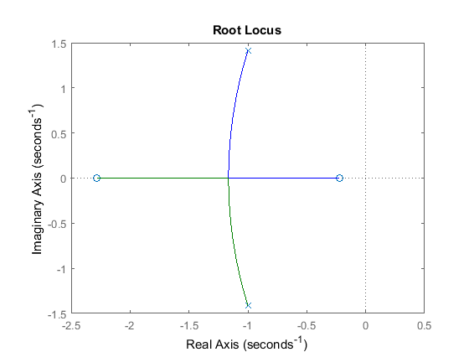
Root Locus Plot
h = tf([2 5 1],[1 2 3]);
rlocus(h)
snapnow;

Slide 38
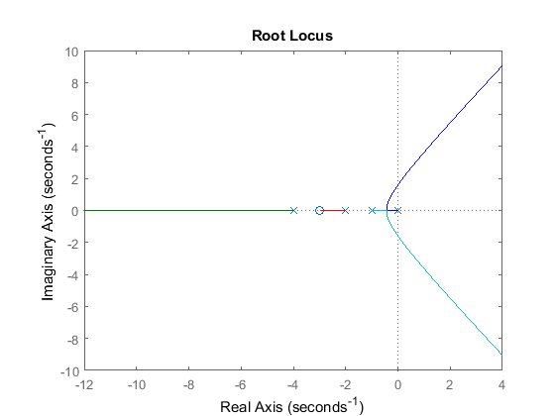
Example from textbook
syms s
x = s*(s+1)*(s+2)*(s+4)
den = sym2poly(x)
num = (s+3)
num = sym2poly(num)
h = tf([num],[den])
rlocus(h)

Slide 39
x =
s*(s + 1)*(s + 2)*(s + 4)
den =
1 7 14 8 0
num =
s + 3
num =
1 3
h =
s + 3
--------------------------
s^4 + 7 s^3 + 14 s^2 + 8 s
Continuous-time transfer function.

Slide 40
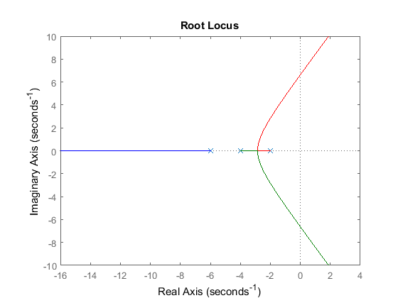
x = (s+2)*(s+4)*(s+6)
den = sym2poly(x)
h = tf([1],[den])
rlocus(h)

Slide 41
x =
(s + 2)*(s + 4)*(s + 6)
den =
1 12 44 48
h =
1
------------------------
s^3 + 12 s^2 + 44 s + 48
Continuous-time transfer function.

Slide 42
syms s K EPS
x =s^4+ 7*s^3+14*s^2+(8+K)*s+3*K
polyVec = [1 7 14 8+K 3*K]
xD = routh(polyVec, EPS)
xD = simplify(xD)

Slide 43
x =
s^4 + 7*s^3 + 14*s^2 + (K + 8)*s + 3*K
polyVec =
[ 1, 7, 14, K + 8, 3*K]
xD =
[ 1, 14, 3*K]
[ 7, K + 8, 0]
[ 90/7 - K/7, 3*K, 0]
[ (K^2/7 + (65*K)/7 - 720/7)/(K/7 - 90/7), 0, 0]
[ (3*K*(K/7 - 90/7)*(K^2 + 65*K - 720))/((K - 90)*(K^2/7 + (65*K)/7 - 720/7)), 0, 0]
xD =
[ 1, 14, 3*K]
[ 7, K + 8, 0]
[ 90/7 - K/7, 3*K, 0]
[ (K^2 + 65*K - 720)/(K - 90), 0, 0]
[ 3*K, 0, 0]

Slide 44
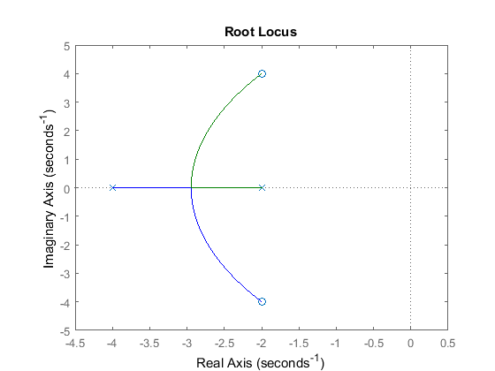
polyVec = [1 6 8]
routh(polyVec,EPS)
% stable function
rlocus(tf([1 4 20],[1 6 8]))

Slide 45
polyVec =
1 6 8
ans =
[ 1, 8]
[ 6, 0]
[ 8, 0]

Slide 46
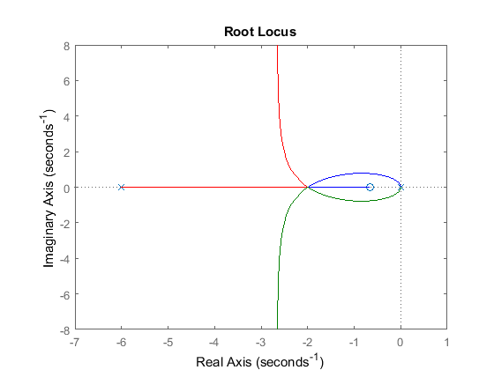
Question 8--4
num= tf([1 2/3])
den = tf([1 6 0 0])
sys = tf([1 2/3], [1 6 0 0])
rlocus(sys)

Slide 47
num =
From input 1 to output:
1
From input 2 to output:
0.6667
Static gain.
den =
From input 1 to output:
1
From input 2 to output:
6
From input 3 to output:
0
From input 4 to output:
0
Static gain.
sys =
s + 0.6667
-----------
s^3 + 6 s^2
Continuous-time transfer function.

